Slide 1
Heart Disease Data Analysis : Report Unified Mentor
By: Israr mohammed
Email : israr4075@gmail.com
Mobile: +91 7737136423
Looking for Work Opportunities
LinkedIn : https://www.linkedin.com/in/israrmohammed/

Slide 2
01
Introduction
Project Description , Data and Libraries used

Slide 3
Problem Statement
Overview
Tools and Libraries
Health is real wealth, and during the pandemic, we all realized the brute effects of COVID-19 on everyone, irrespective of status; therefore, you are required to analyze health and medical data for better future preparation to understand and mitigate the risks associated with heart disease.
ETL Process:
- Use Python libraries such as pandas for data manipulation.
- Utilize Jupyter Notebook for database interactions.
Exploratory Data Analysis (EDA):
- Perform EDA with pandas using Python.
- Visualize data with matplotlib and seaborn.
- Focus on insights related to heart disease rates, gender, and age.

Slide 4
Data: Attributes
age
sex
chest pain type (4 values)
resting blood pressure
serum cholestoral in mg/dl
fasting blood sugar > 120 mg/dl
resting electrocardiographic results (values 0,1,2)
maximum heart rate achieved
exercise induced angina
oldpeak = ST depression induced by exercise relative to rest
the slope of the peak exercise ST segment
number of major vessels (0-3) colored by flourosopy
thal: 0 = normal; 1 = fixed defect; 2 = reversable defect
Codes Link : https://drive.google.com/file/d/1iIzeTrCtM3cIaA6VlDw2dpZgEnJHlI9x/view?usp=sharing

Slide 5
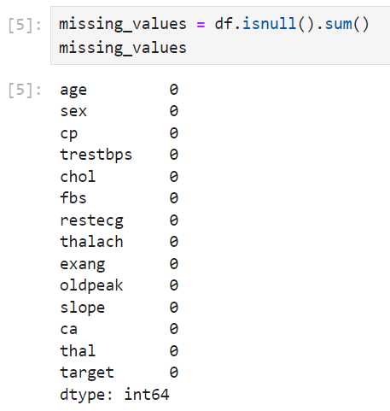
Null Value Check!

Slide 6
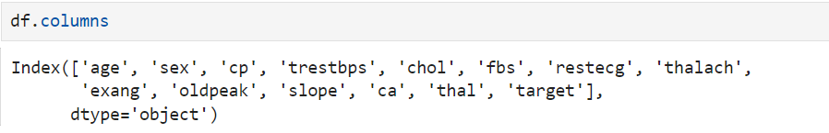
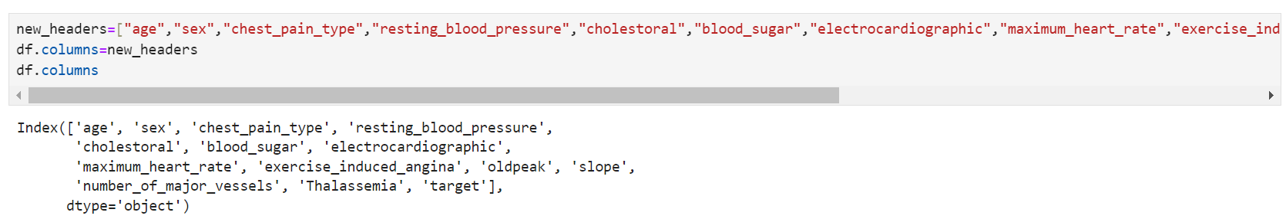
Attribute Name Change
old names
new names
age | sex
chest_pain_type | resting_blood_pressure
cholesterol | blood_sugar
electrocardiographic | maximum_heat_rate
exercise_induced_agina | oldpeak
slope | number_of_major_vessels
thalassemia | target

Slide 7
02
Analysis and Insights
Statistics , Graphs and charts d

Slide 8
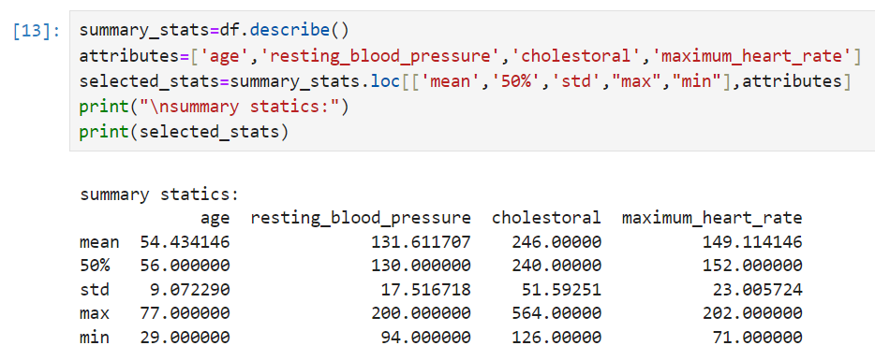
Basic Statistics
summary statistics (mean, median, standard deviation, min and max) for numerical attributes like age, blood pressure, cholesterol, and heart rate.
It shows a middle-aged population with slightly elevated average blood pressure and cholesterol levels. Maximum heart rate varies widely but generally falls within expected physiological ranges.

Slide 9
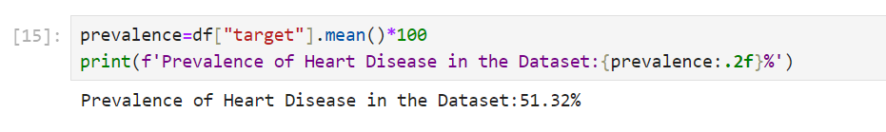

Basic Statistics
Prevalence : The prevalence of heart disease in the dataset is calculated as 51.32%, indicating that slightly over half of the individuals in the sample have been diagnosed with heart disease.
Distribution : Out of 1025 individuals in the dataset, approximately 69.56% are male (713 individuals), and 30.44% are female (312 individuals). This gender distribution is crucial for understanding the prevalence of heart disease across genders in the sample.

Slide 10
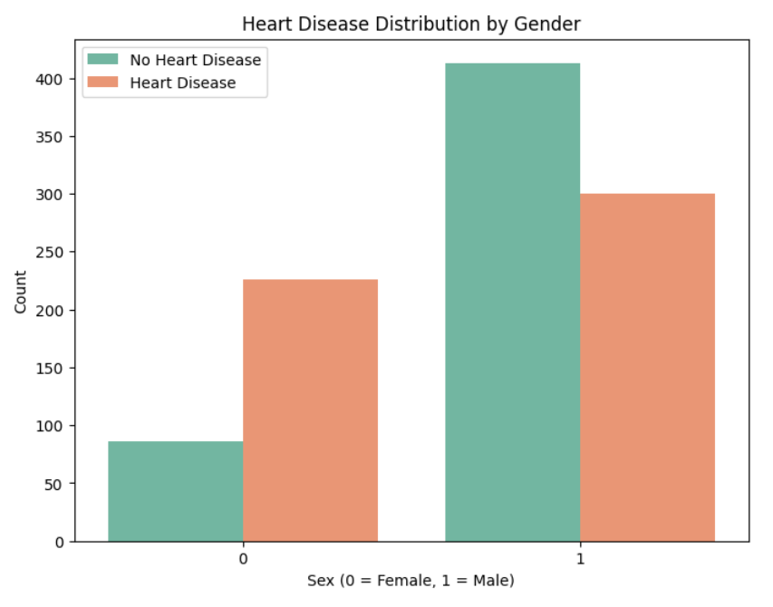
Distribution by Gender
Heart disease is more prevalent among men, consistent with a higher proportion of male samples in the dataset. This suggests that while males outnumber females in the dataset, both genders exhibit similar percentages of heart disease prevalence.

Slide 11
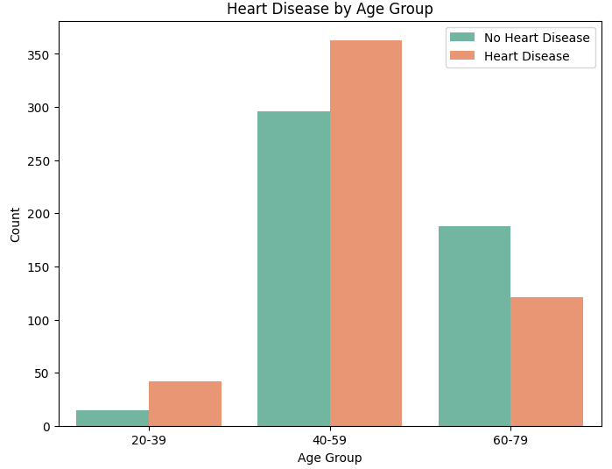
Distribution by Age Group
The prevalence of heart disease increases with age, peaking in midlife.

Slide 12
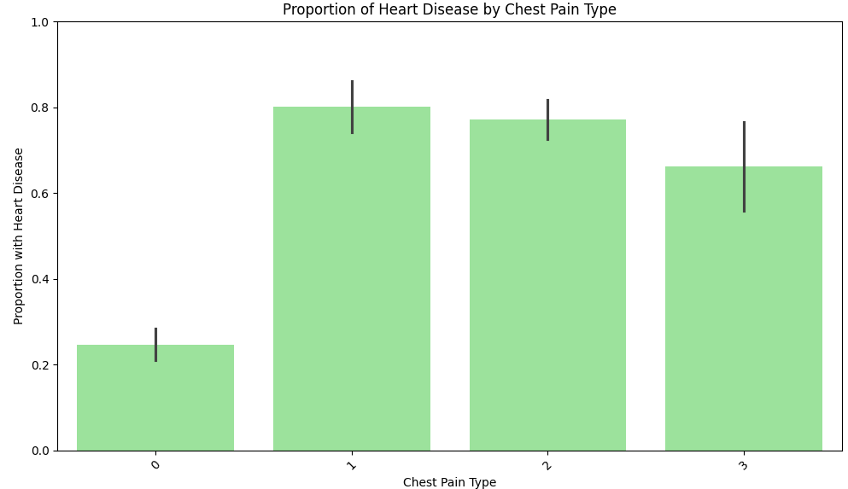
Distribution with Type of Chest Pain
Type 1 and 2 chest pain types indicate higher chances of having heart disease, with type 1 showing approximately 80% and type 2 around 70% likelihood based on data analysis.

Slide 13
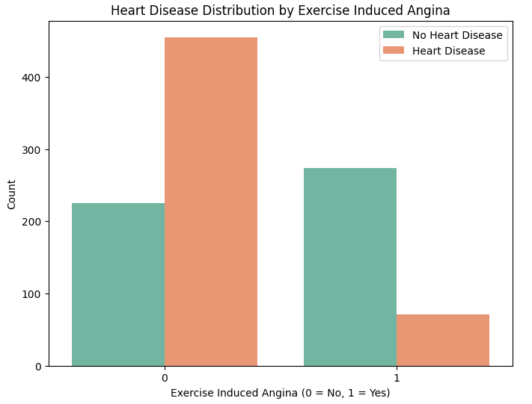
Exercise induced Agina by heart Disease
Most of the sample does not have exercise-induced angina, suggesting that heart disease factors related to this condition are minimal in this particular sample.

Slide 14
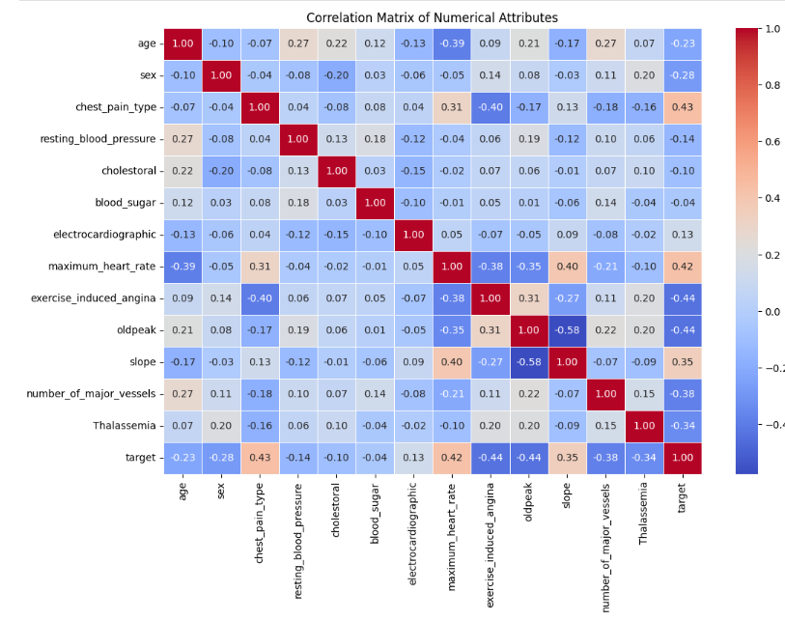
Correlation

Slide 15
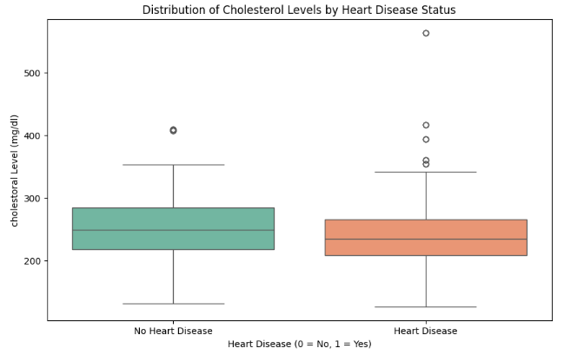
Heart Disease by Cholesterol
Cholesterol level among those are way over range for Heart Disease Patient.
There are higher outlier with heart disease and cholesterol.

Slide 16
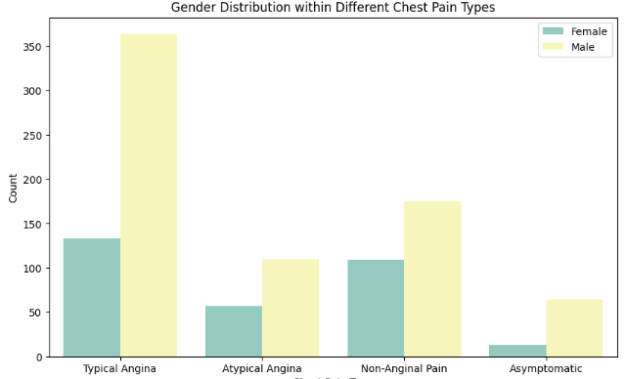
Chest Pain with Gender
Most Cases are of Typical Agina and in which too are more of male patient.

Slide 17
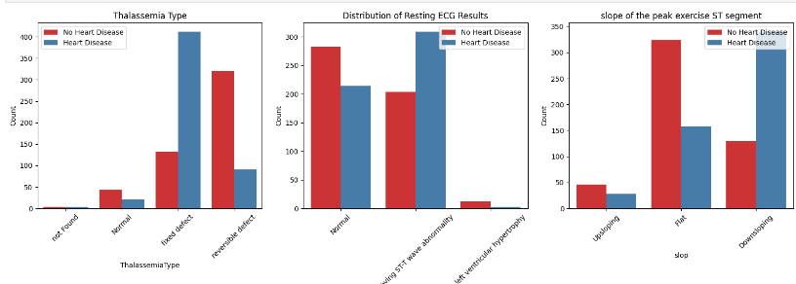
More Insights
Following shows more heart Disese with different attribute distribution.

Slide 18
Conclusion
Age: Average 54.4 years (Range: 29-77)
Resting Blood Pressure: Average 131.6 mmHg (Range: 94-200 mmHg)
Suggests slight elevation compared to normal (<120/80 mmHg)
Cholesterol Level: Average 246 mg/dL (Range: 126-564 mg/dL)
Elevated above the healthy range (<200 mg/dL)
Maximum Heart Rate: Average 149.1 bpm (Range: 71-202 bpm)
Slightly lower than expected for similar age groups

Slide 19
Conclusion
Prevalence of Heart Disease: 51.32% of the sample has heart disease.
Gender Analysis:
Among those with heart disease, females outnumber males.
Conversely, among those without heart disease, there are more males than females.
Age Groups and Heart Disease:
Individuals aged 40-59 years show the highest prevalence of heart disease.
The 20-39 age group has lower prevalence compared to 40-59 years.
The 60-79 age group exhibits the lowest prevalence.
The 40-59 age group is not only most affected by heart disease but also constitutes the largest segment of the sample.

Slide 20
Conclusion
Thalassemia Type :
Reversible' or 'fixed defect' types link to higher heart disease prevalence.
'Normal' type shows lower incidence, 'not found' type mixed but generally lower prevalence.
Resting ECG Results :
'Left ventricular hypertrophy' correlates with higher heart disease.
'Normal' and 'ST-T wave abnormality' vary, 'Normal' usually lower.
Slope of Peak Exercise ST Segment :
'Downsloping' ST segment associates with higher heart disease.
'Flat' and 'upsloping' vary, 'upsloping' generally lower.

Slide 21
Conclusion
Correlation Matrix :
Age, max heart rate, and possibly cholesterol correlate with heart disease.
Scatter Plot: Age vs. Max Heart Rate :
Heart disease linked to lower max heart rates with age.
Gender and Chest Pain Types :
Gender impacts chest pain reporting.
Cholesterol Levels (Box Plot) :
Higher in heart disease cases.
Major Vessels Colored (Bar Plot) :
More vessels colored indicates more heart disease cases.

Slide 22
Thanks!
Do you have any questions?
israr4075@gmail.com
+34 654 321 432
yourwebsite.com
Please keep this slide for attribution

